Slide 1
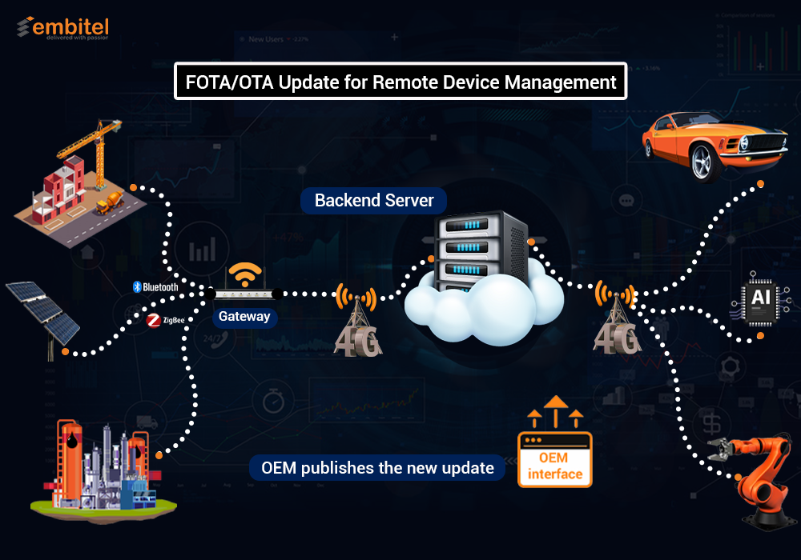



Slide 2

Team Members
Mohamed Hafez Mohamed
Abdelrhman Mosad Abdelhady
Our Team
Osama Salah Hijazi
Supervisor
prof.dr., Sherif Keishk

Slide 3
What is FOTA?
Embedded systems challenges
Problem statement
Why not widely used ?
FOTA benefits
Abstract view
Connection to cloud
Gateway
Encryption
CAN
Bootloader
AUTOSAR and SW design
Test cases
Tools

Slide 4
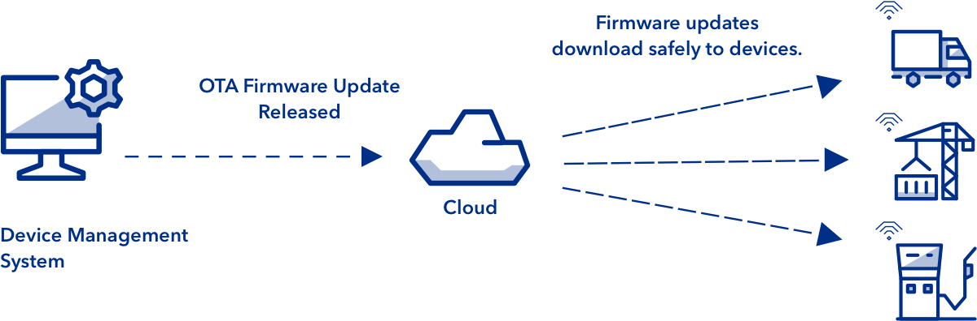
What is fota ?
Firmware-over-the-air (FOTA) is a technology that enables the operating firmware of a device to be upgraded and updated wirelessly over the network (“over the air”) without the need to connect directly to the device. FOTA-capable devices can download updates from service providers or manufacturers in short time This saves the time and money spent sending a technician.

Slide 5
Embedded systems challenges
1 – Limited resources. ( Limited RAM, ROM, Processing and time ).
2 – Maintainability of the software over the life cycle of software and that was very hard because we have to connect through wires to flash new software.

Slide 6
Problem Statement
It is essential for companies to manage the software efficiently over the lifecycle of the device, to provide improvements and to deliver corrections to faulty software that endanger lives or the environment.
What happen to these devices when millions of units have been shipped and a software “enhancement” needs to be made? Does every unit need to be returned to the manufacturer every time the software is updated?
With the gross of fields like IOT and automotive the process of updating and keeping the software clean of bugs have been become harder and harder.

Slide 7

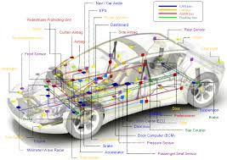
Problem Statement
Examples:
A network in IOT system could have thousands or even millions of embedded devices scattered over a large area a city for example.
In Automotive a car had at least 20 million to 30 million lines of code and 100 to 200 different ECU.

Slide 8
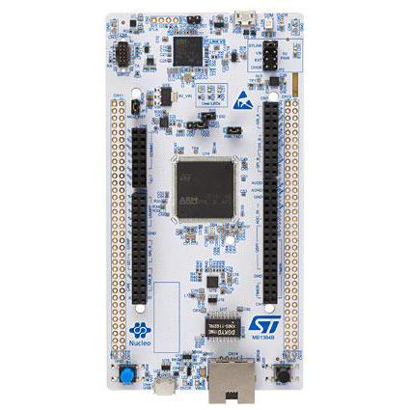
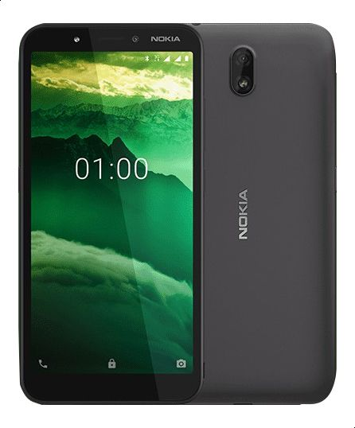
WHY FOTA NOT WIDLY USED YET ?
OTA is a will established concept already with cell phones and PCs but what is the difference?
Embedded devices | Mobile phones
Limited resources, for example one of the most powerful MCUs is STM32 H7 : Frequency up to 400 MHz Up to 2 Mbytes of Flash memory 1 Mbyte of RAM 32-bit Arm® Cortex®-M7 core | Resources are not limited for example a very cheap cell phone like Nokia c1: Frequency 1.3 GHz 16 GB storage 1 GB RAM Quad-core
No room to install powerful OSs like Linux, the OS used to develop the application will probably a real time OS which will mange time. | Runs a powerful OS whish is android (Linux-based) and will mange both time and hardware.

Slide 9
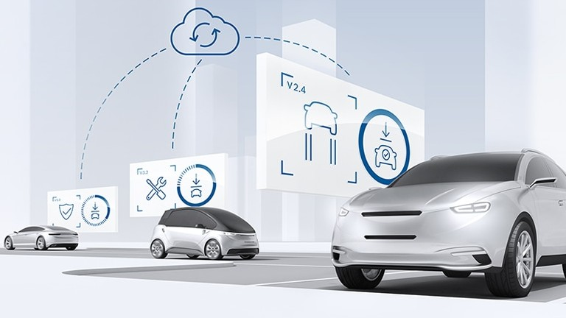
Fota benefits
OTA technology will provide:
It can seamlessly manage firmware updates across a fleet of IOT devices from one unified interface, the costs significantly will decrease.
Bug issues can be fixed, and product behavior can be enhanced.
It enables manufacturers to add new features after the release without physical access.
Faster time-to-market.
Improved safety and compliance.

Slide 10
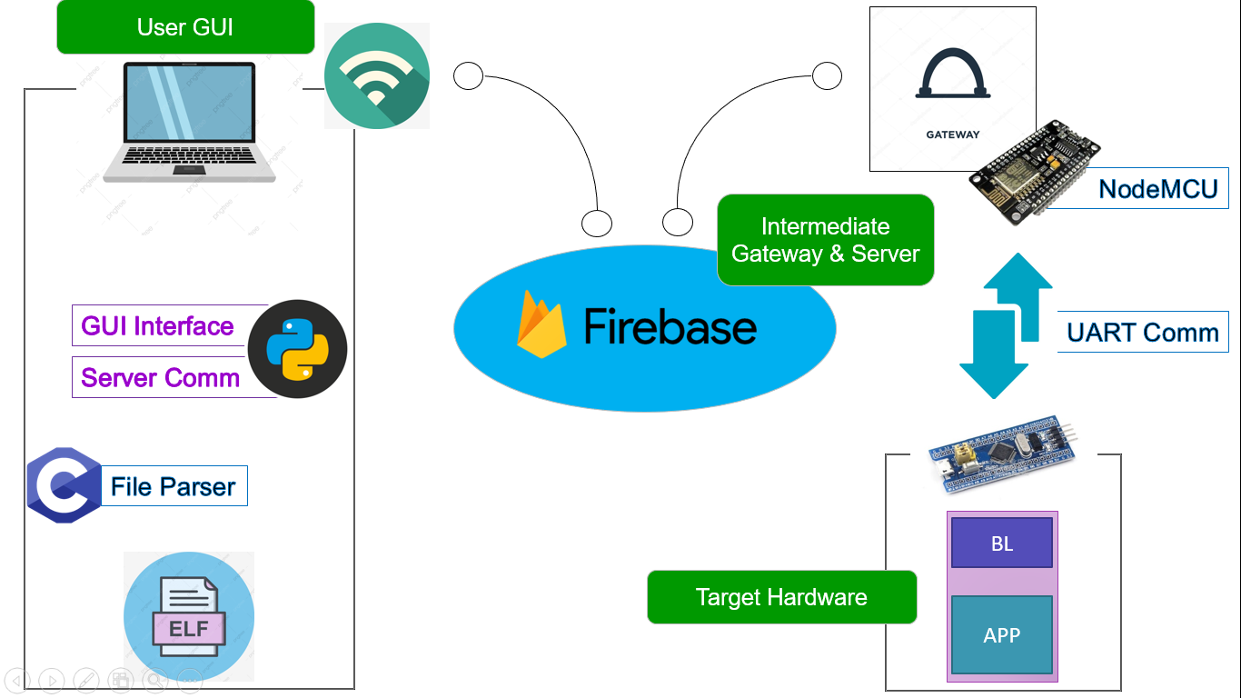
Abstract view
The project is divided into two phases, based on the Embedded systems domains and on the workflow to achieve an incremental workflow.
The first phase targeted devices with only on Microcontroller :

Slide 11
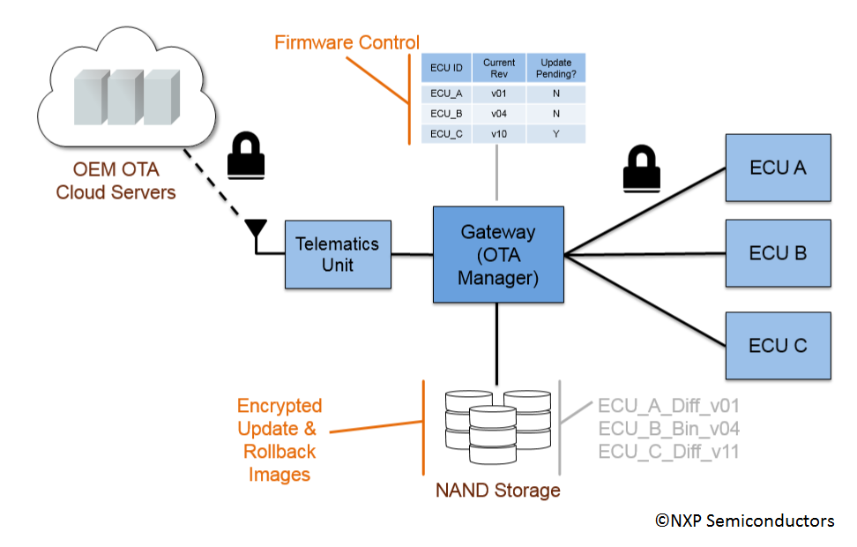
Abstract view
The Second phase targeted devices with many ECUs like vehicles where software and system is more complexed :

Slide 12
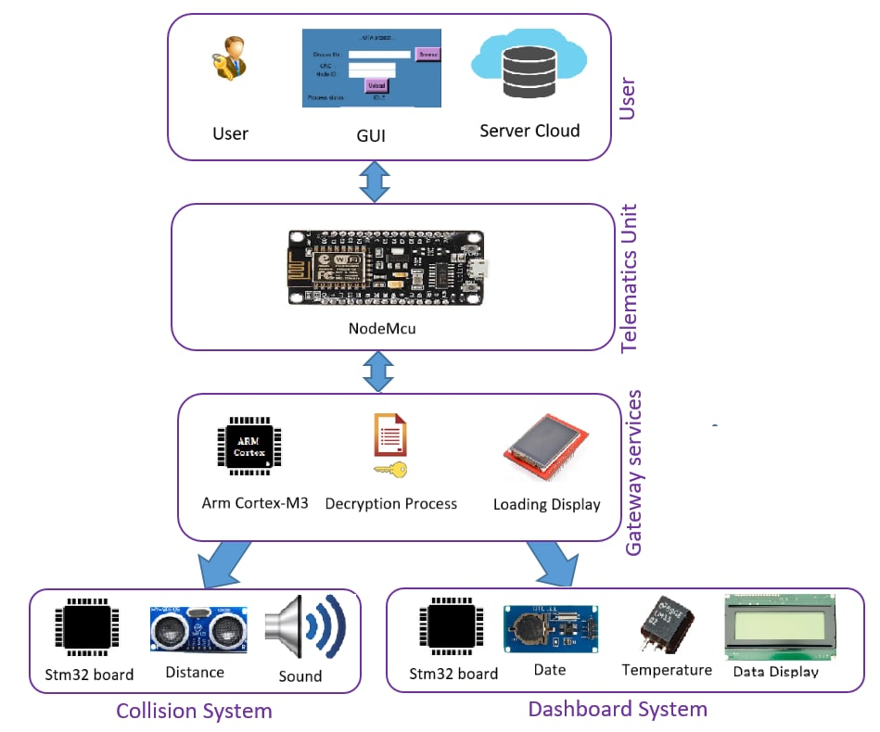

Slide 13
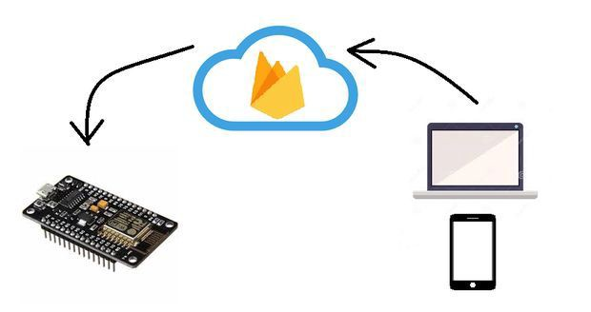
Connection TO cloud
Connection is made through :
Firebase as server.
Friendly GUI to upload updates.
Node MCU as telematics unit.

Slide 14
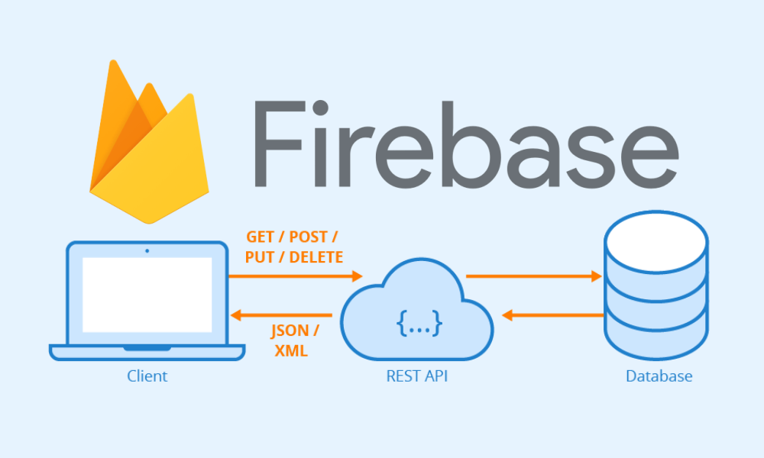
Firebase
Is Google's mobile platform that helps you quickly develop high-quality apps.
Main advantage is the real time database and storage.
It is the server that will connect the remote user to the ES device.
The new code will be uploaded to it from remote PC so the node MCU will download code from it.

Slide 15
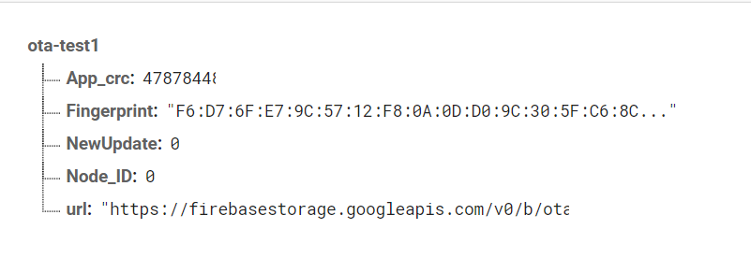
Firebase
Using Real time database for storing information about the update like :
CRC value
ECU ID
Download link
A flag to notify the node of new update.

Slide 16
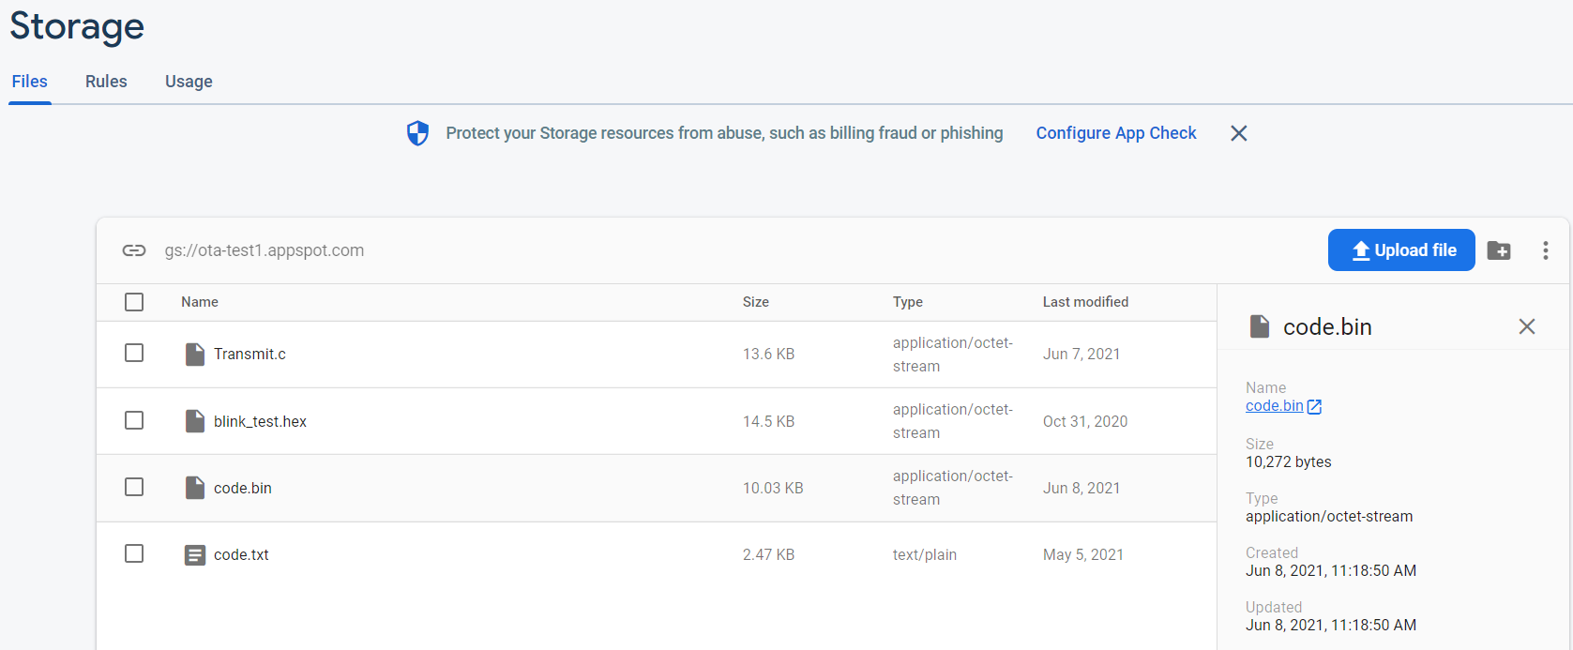
Firebase
Using firebase storage to store the code in binary format so node will download it later from the storage.
The code will be uploaded to storage through the GUI.

Slide 17
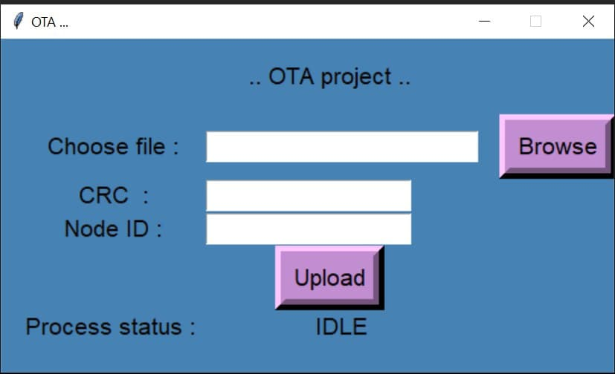
GUI
GUI is to make it easier for the user to upload updates to firebase and the related information of the update.
The file will be in hex format the application will convert to binary then upload it.
If the last update wasn’t downloaded yet by the node the application will block the user from uploading new update.
The application will keep showing the update status till completed.

Slide 18
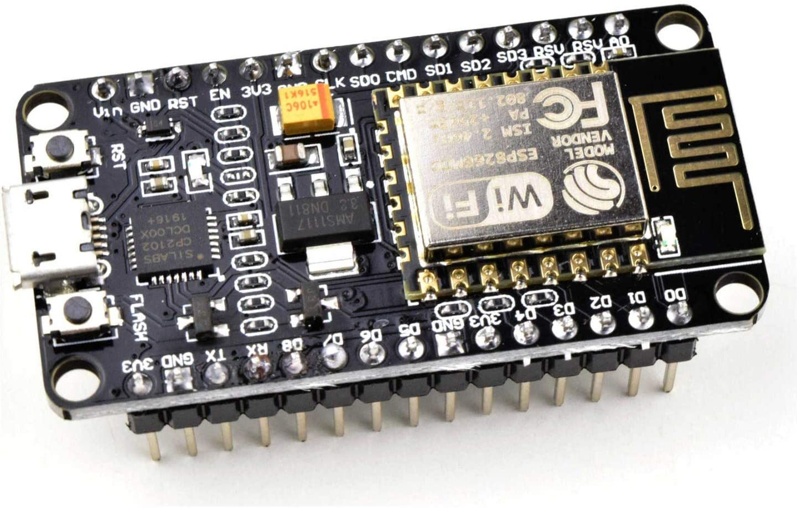
Node MCU
Is an open-source development board and firmware based in the widely used ESP8266 -12E Wi-Fi module.
It is our way to connect to internet and download the update.
Easy to program and has stable performance.

Slide 19
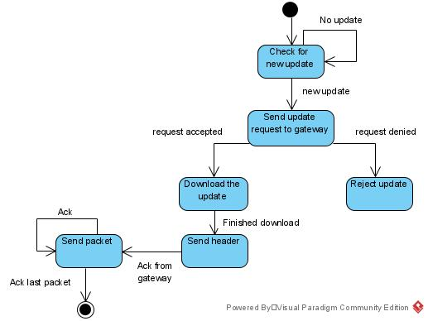
Node MCU state machine

Slide 20
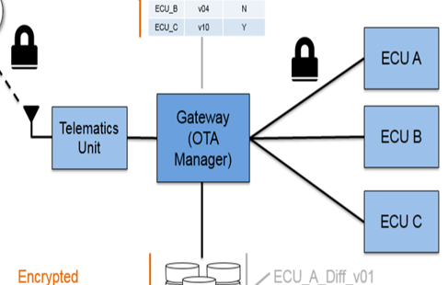
Gateway
The gateway responsibility is :
Save information about connected ECUs.
Decrypt the code.
Check if code is valid.
Determine which ECU this code is for.
Resolve dependencies in case of rollback.
Notify the node when the update is complete.

Slide 21
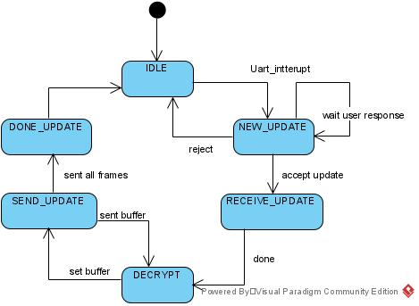
Gateway
State machine:

Slide 22
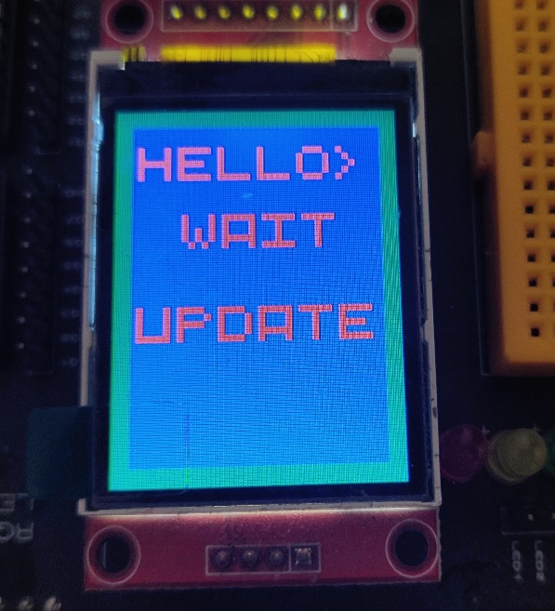
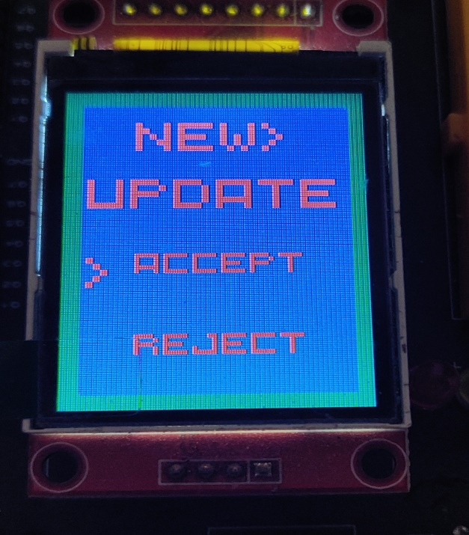
Gateway
Sequence :
1) Gateway remains in idle state waiting a notification from NodeMCU.
2) When gateway receive a notification of new update, will notify the user.
(1)
(2)

Slide 23
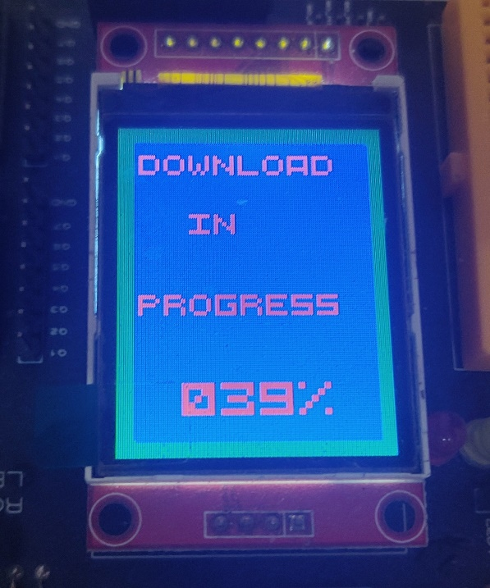
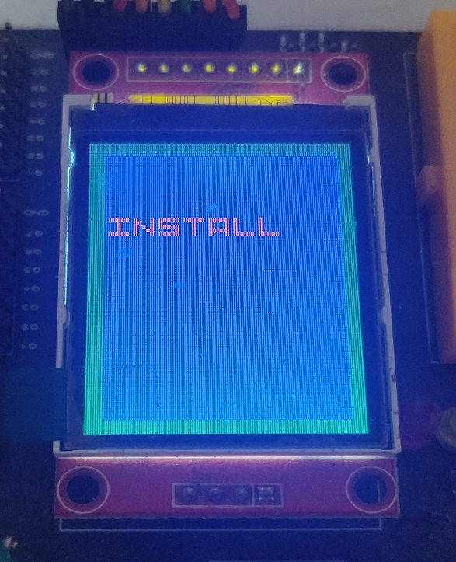
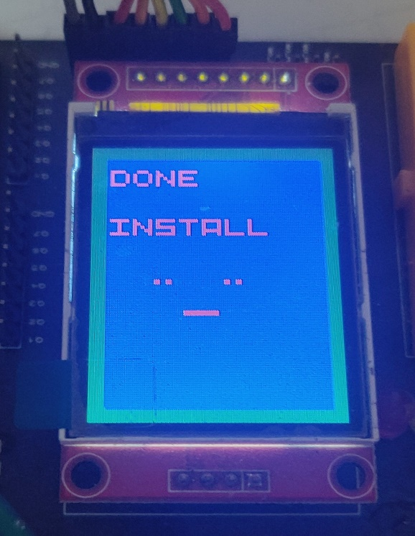
Gateway
3) If the user rejected the update the gateway will return to the idle state but if the user accepted the update the code will be downloaded.
4) When the download finishes and the update will be installed.
5) When the installation is done the gateway will notify the user that update is successful.
(3)
(4)
(5)

Slide 24
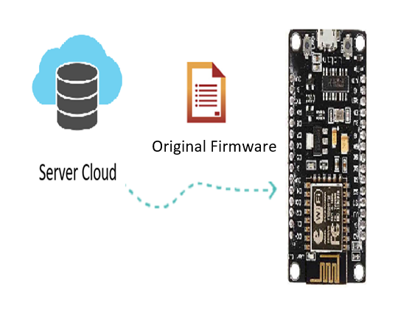
Software Security
Why we secure firmware?
We explained previously that we need to upload the Data to Firebase Cloud storage and send it over the air to Telematics unit so to prevent hackers attack and manipulation; we must apply Strong Encryption Algorithm to the Data.

Slide 25
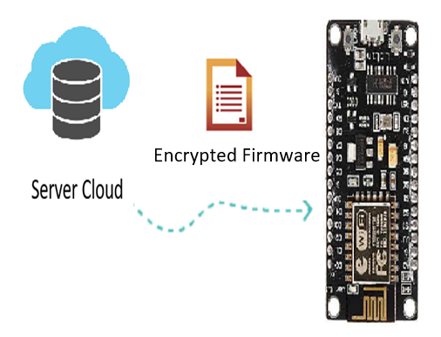
Encryption Algorithms
What is Encryption?
Encryption is the process of encoding a message or information.
Only authorized parties can access encrypted firmware.

Slide 26
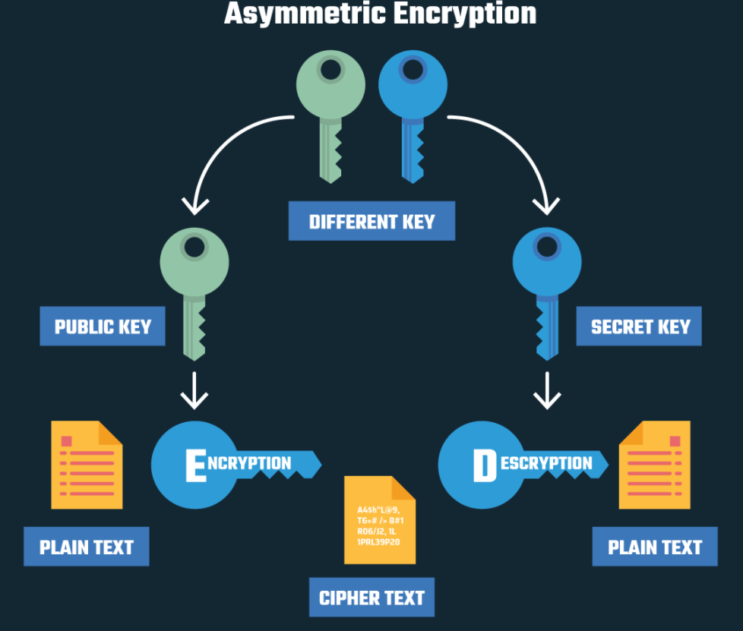
Encryption Algorithms Methods
There are two main encryption methods:
Asymmetric Encryption in which there is a publish key to encrypt Data, but you must have another private key to decrypt(ECC,RSA).

Slide 27
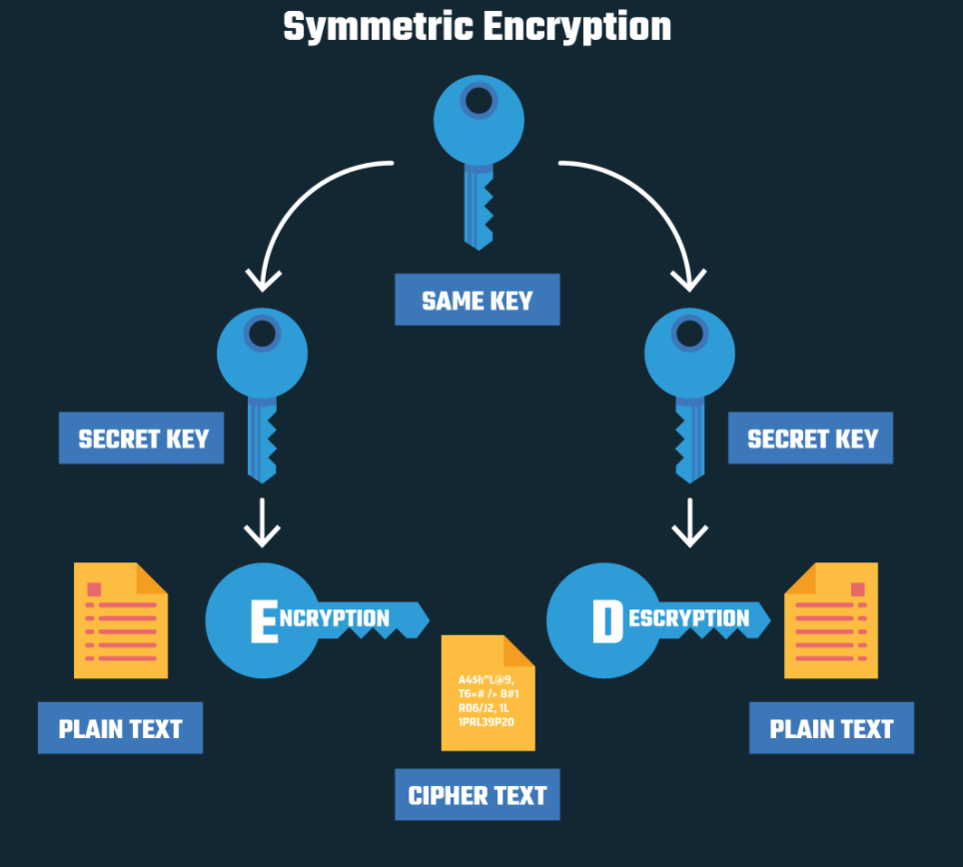
Encryption Algorithms Methods
Symmetric Encryption in which the encryption and decryption keys are the same (AES, RC4, DES).
We choose AES Symmetric method to encrypt the firmware.

Slide 28

AES is the algorithm trusted as the standard by the U.S. government and many other organizations.
AES is the most used security protocol today everything from encrypted data storage to wireless communications.
It is resilient against hacking attempts, thanks to its higher-length key sizes (128, 192, and 256 bits).
This security algorithm may be implemented in both hardware and software.

Slide 29
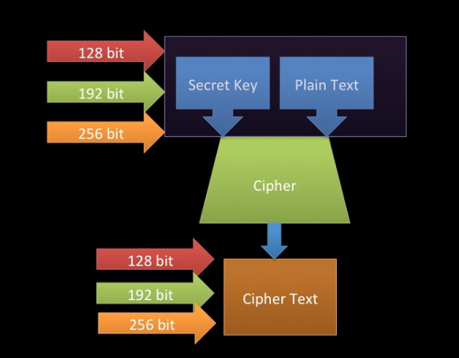
AES Design
Encryption Process inputs are Secret Key and Plain Data/Text and produce Cipher Text.
Decryption Process inputs are Secret Key and Cipher Data/Text and produce Plain Text.

Slide 30
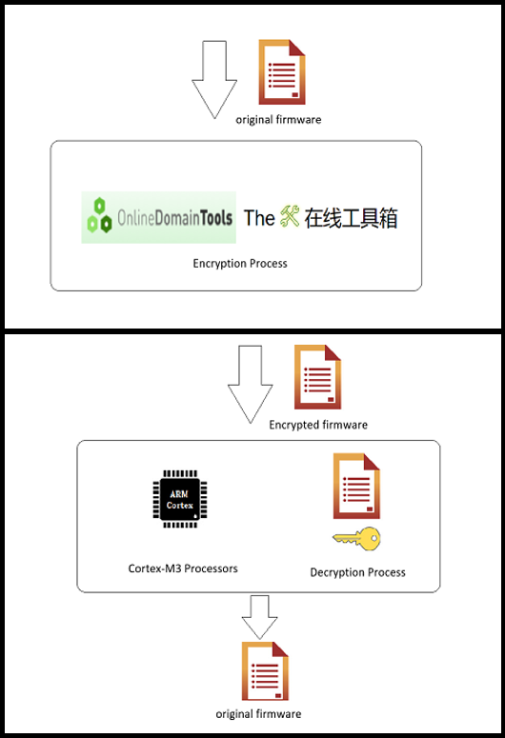
AES Implementation
AES security algorithm may be implemented in both hardware and software.
Encryption: using online tools and websites to encrypt out firmware before upload it to Server Cloud.
Decryption: we prefer to use the code to perform decryption process. this code will performed using stm32f103 microcontroller based on high speed performance processor(cortex-M3).
Testing: we make sure that the code is integrated with online tools.

Slide 31
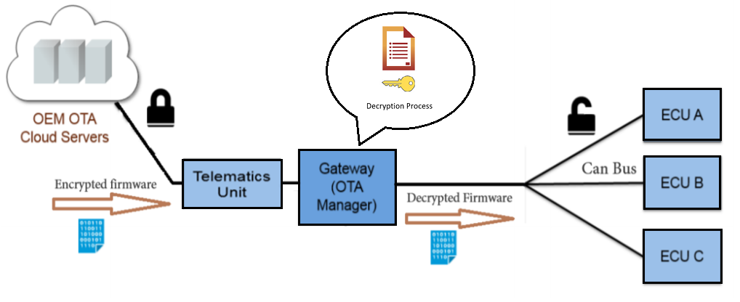
Encryption And Decryption Stages
Encryption And Decryption Stages

Slide 32

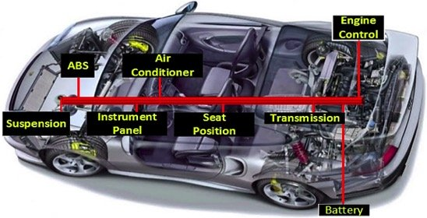
Controller Area Network
Controller Area Network (CAN bus) is a robust vehicle bus
standard designed to allow microcontrollers and devices
to communicate with each other's applications.

Slide 33
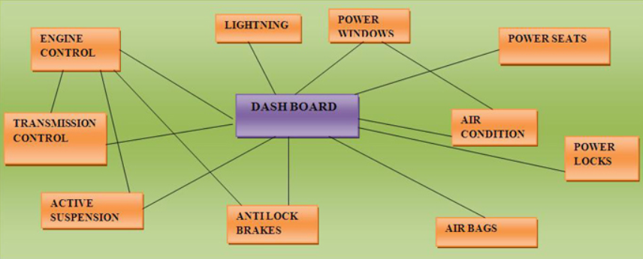
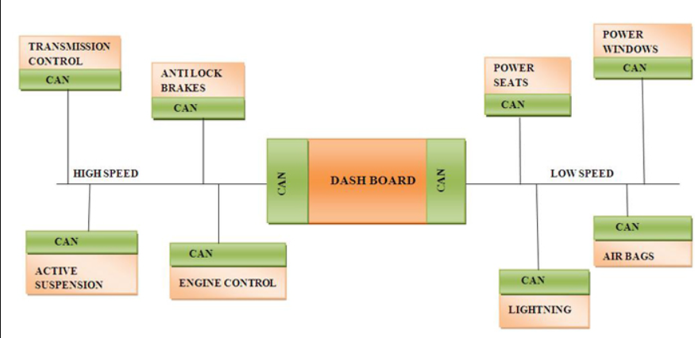
Can Characteristics
Allow Central ECU communicate with internal system ECUs without any overhead and with more stability.

Slide 34
Can Characteristics
Node broadcast it’s message to all nodes on the bus
CAN is message based Not address based.
Distributing control across can Network that allows Master/Slave or Peer/Peer communication.

Slide 35
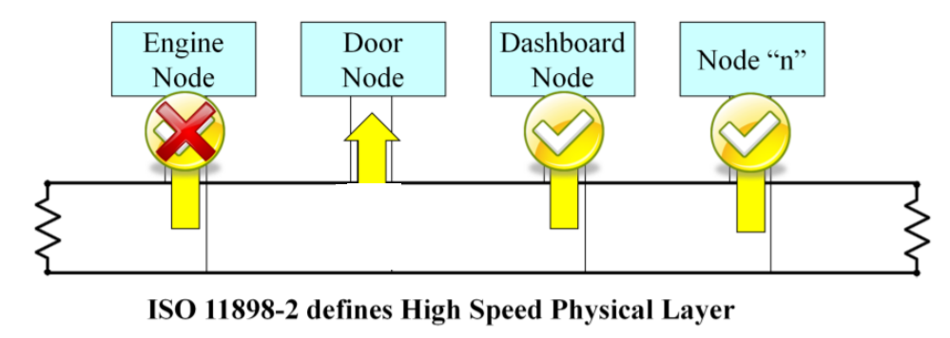
Physical Network
Can network is considered to be a group of nodes.
The smallest Can network contains at least 2 active nodes.
Node modes can be Active , Passive or Bus off .

Slide 36
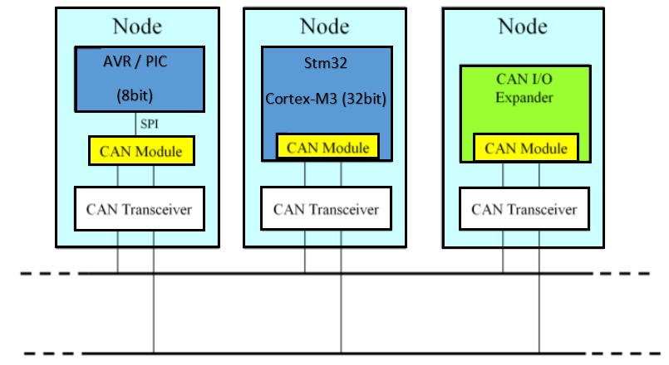
Nodes Types
Various types of nodes can be found on can network bus.
Can I/O expander.
Nodes support Can module.
Nodes don’t support Can module
but using external Can module.
Node type 2 is the hardest one.

Slide 37
Can Bus Frames
Data Frame (standard or Extended).
Remote Frame (standard or Extended).
Error Frame (Passive or Active).
Overload Frame

Slide 38
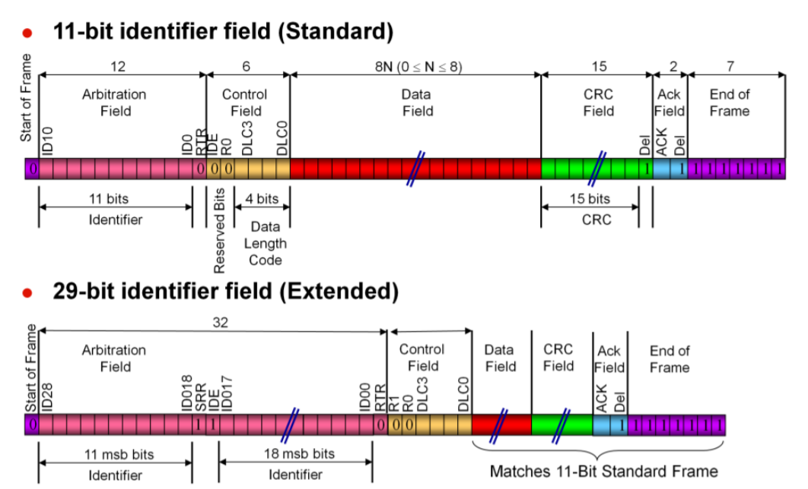
Data Frame
Data Frame are used to transmit information between a source node and one or more receivers.

Slide 39
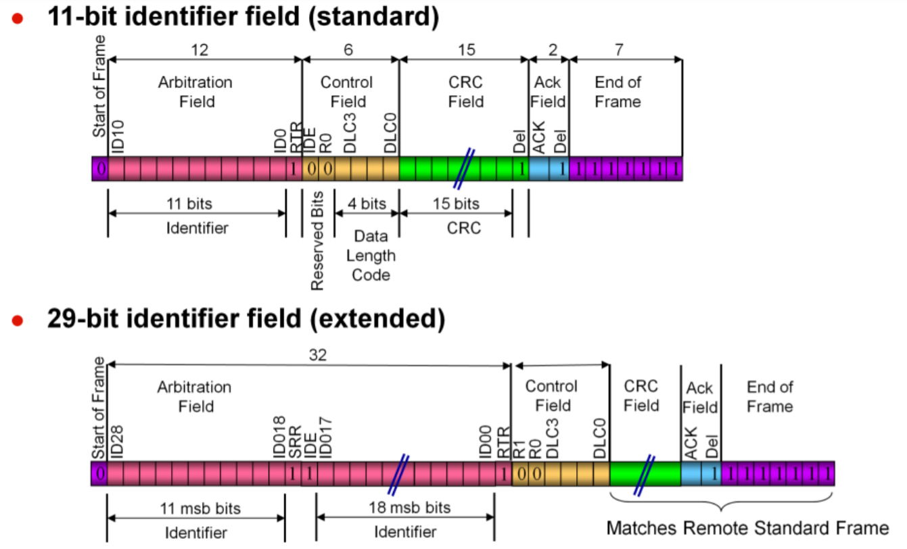
Remote Frame
Remote Frame requests the transmission of a message by another node.

Slide 40
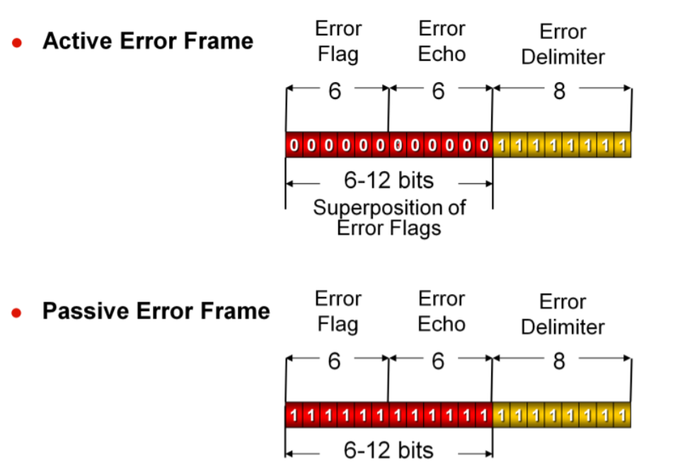
Error Frame
Any Node can transmit error frame when detect an error with data or remote frames.

Slide 41
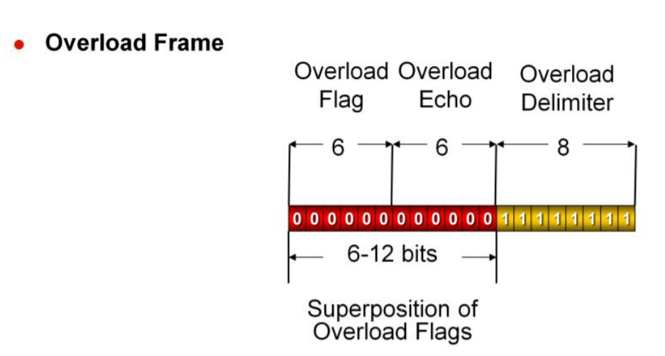
Overload Frame
Is request all nodes on the network to delay sending out the next Data or Remote Frames thus given that node more time to process the current message.

Slide 42
Can Techniques
Can Filtering:
This technique is also used when monitoring a CAN bus, to focus in on messages of importance using an identifier and mask.
Identifier: allows me to add one acceptable ID to filter registers.
Mask : allows to add a range of acceptable IDs to filter registers
Can FIFO Buffer :
First in First Out concept using in CAN to Store multiple Message.

Slide 43
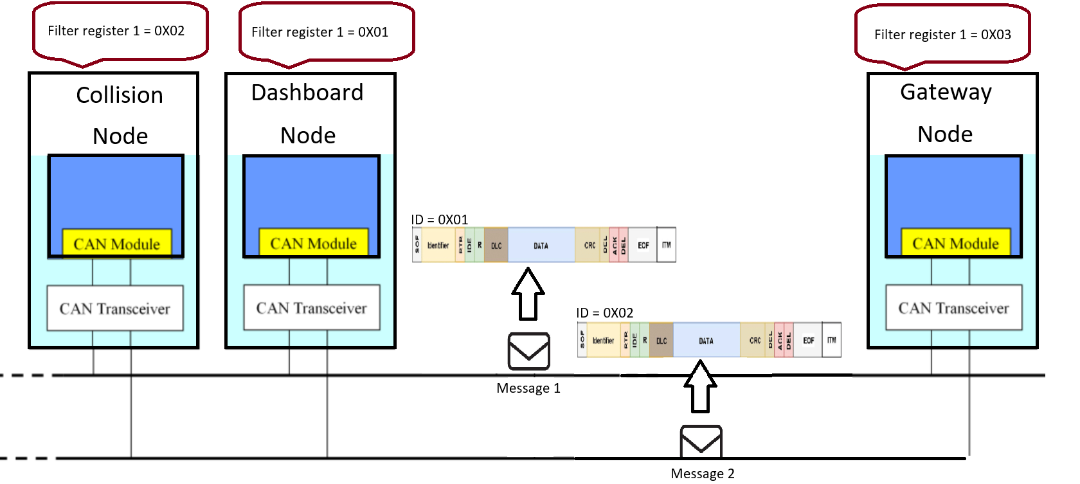
Communication between Gateway and nodes

Slide 44
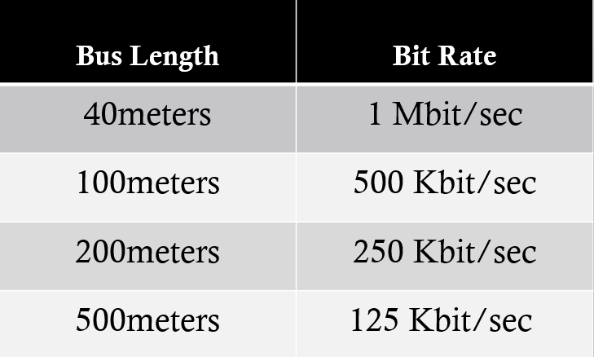
CAN Network speed
The maximum number of nodes on a CAN bus is theoretically unlimited but practically 32 Nodes.
Data Rate : 1Mbps in CAN and up to 2+ Mbps in CAN-FD.

Slide 45
Bootloader Requirements
Definition: It’s an application whose primary purpose is to allow a system software to be updated without the use of specialized hardware such as a off circuit programmer and in circuit programmer.
Requirements.
Ability to switch or select the operating mode (Application or bootloader).
Communication protocol (USB, CAN, I2C, UART).
Record parsing requirement (S-Record, hex).
Flash system requirements (erase, write, read).
EEPROM requirements (erase, read, write).
Error detection mechanism (checksum, crc,…).
Security and encryption.

Slide 46
Bootloader State Machine

Slide 47
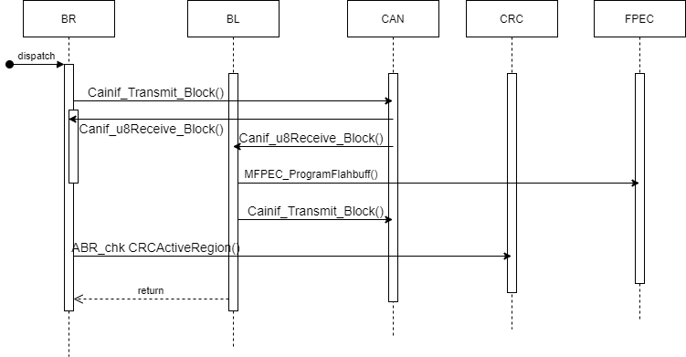
Bootloader Sequence diagram

Slide 48
Bootloader Sequence diagram

Slide 49
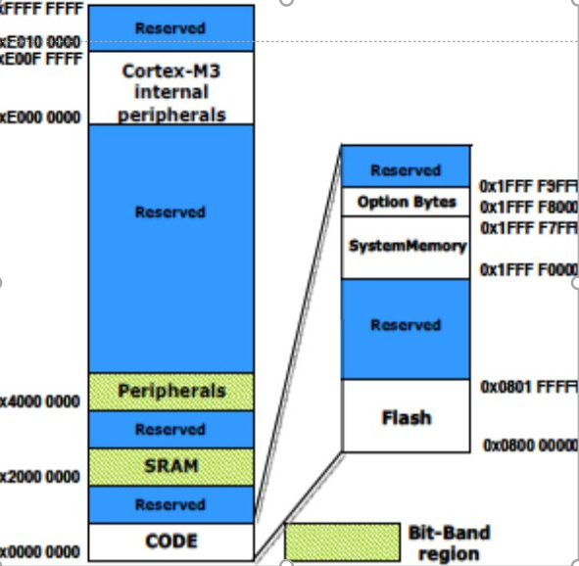
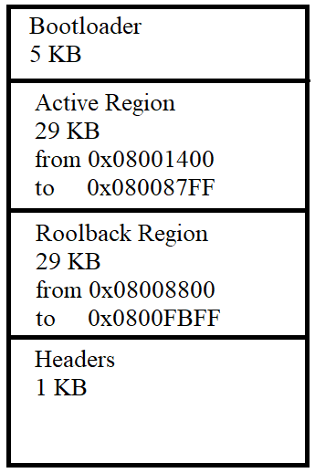
Memory Partitioning

Slide 50
Error Detection
A cyclic redundancy check (CRC) is an error-detecting code commonly used in digital networks and storage devices to detect accidental changes to raw data.
Blocks of data entering these systems get a short check value attached, based on the remainder of a polynomial division of their contents.
Our MCU support circuit to calculate crc.
We used it to check the integrity of the images by checking
The calculated one with the received crc sent with code in header.

Slide 51
SW DESIGN

Slide 52
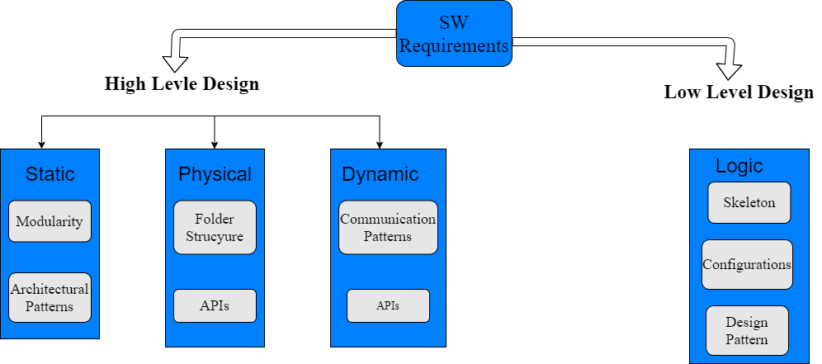
SW Design

Slide 53

Autosar Introduction
Automotive Open System Architecture (AUTOSAR) is a global Development partnership of automotive interested parties founded in 2003.

Slide 54
Motivation For Autosar
Increasing complexity of modern vehicles and especially their Electronic and Electrical systems
Quantity of Software rising very steeply.
Poor reusability : Software must often be rewritten from scratch when hardware (processor type) is changed.

Slide 55
The Autosar Approach
ARCHITECTURE.
METHODOLOGY.
INTERFACES.

Slide 56
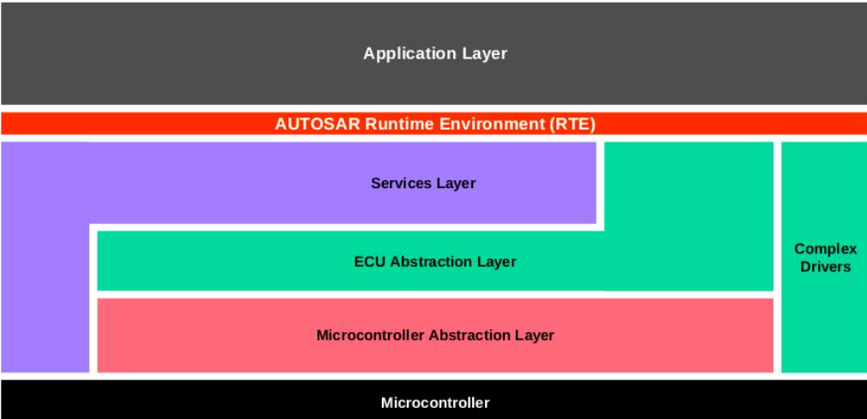
Autosar Layered Architecture
Providing progressive degrees of abstraction that promote application and basic software re-use and relocate ability.

Slide 57
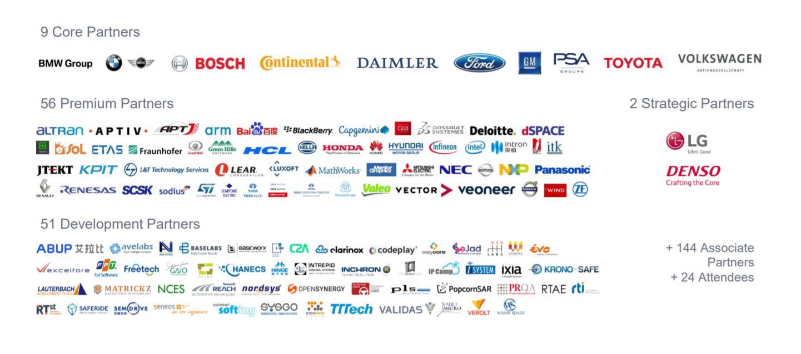
Autosar Methodology
Systematic method of working between suppliers and OEMs ,seamless interactions with a common configuration language.

Slide 58
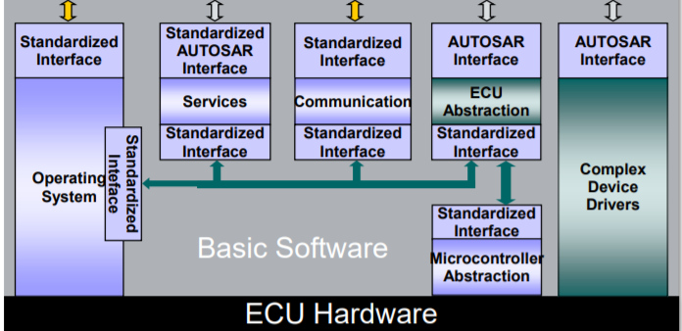
Autosar Interfaces
Every module has its predefined Interfaces that the developer must follow During developing the code.
ECU Abstraction Layer Provides an API for access to peripherals and devices regardless of their location and their connection to the microcontroller.

Slide 59
Autosar Objectives
Scalability
Avoid SW redundancy by using same standard modules on all ECUs.
Transferability
Ability to transfer a SW Application from an ECU.
Interoperability
By standardizing interface between different SW Layers enable us using SW
And HW from Different suppliers

Slide 60
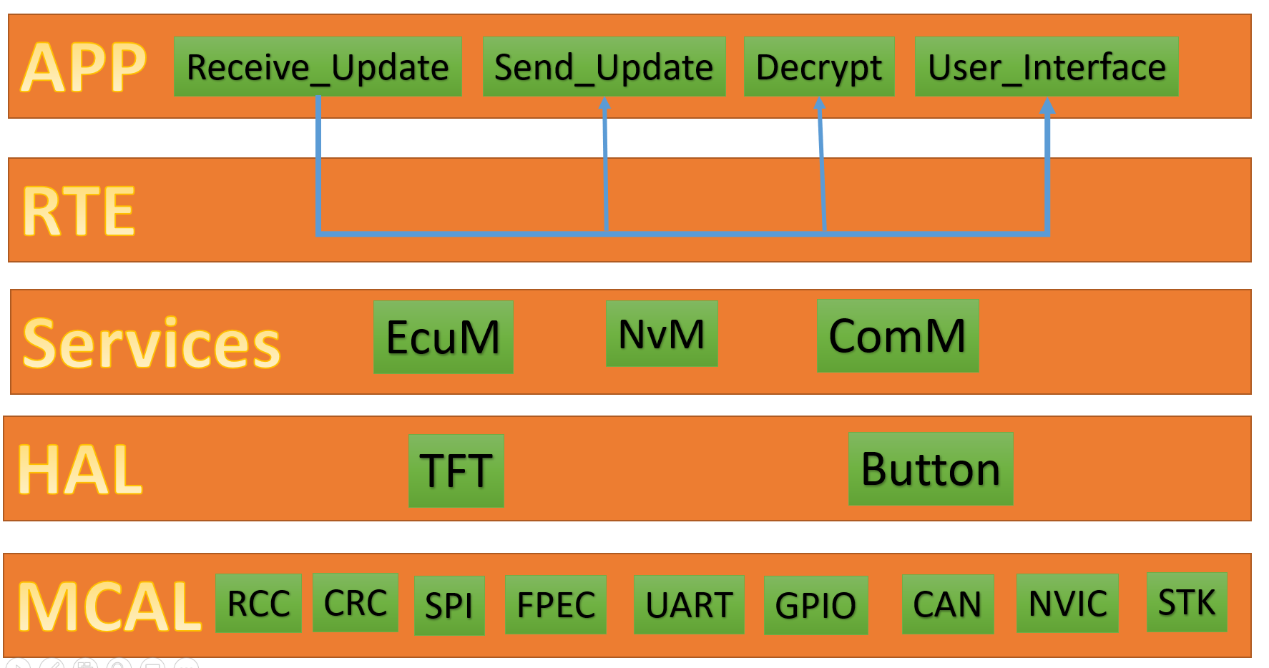
Gateway
Layered architecture :

Slide 61
Test cases
We developed two test cases simulating two systems from the cars :
Dashboard system: monitor some parameters like speed and temperature and display to the user.
Collision system: to warn the driver if he is about to hit an object.
 | Dashboard system | Collison system
Code size | 10.1 KB | 3.60 KB
Code CRC | 0x6C990BF6 | 0x8697B25D
Node ID | 1 | 0
Flashing time | 52 sec | 23 sec

Slide 62
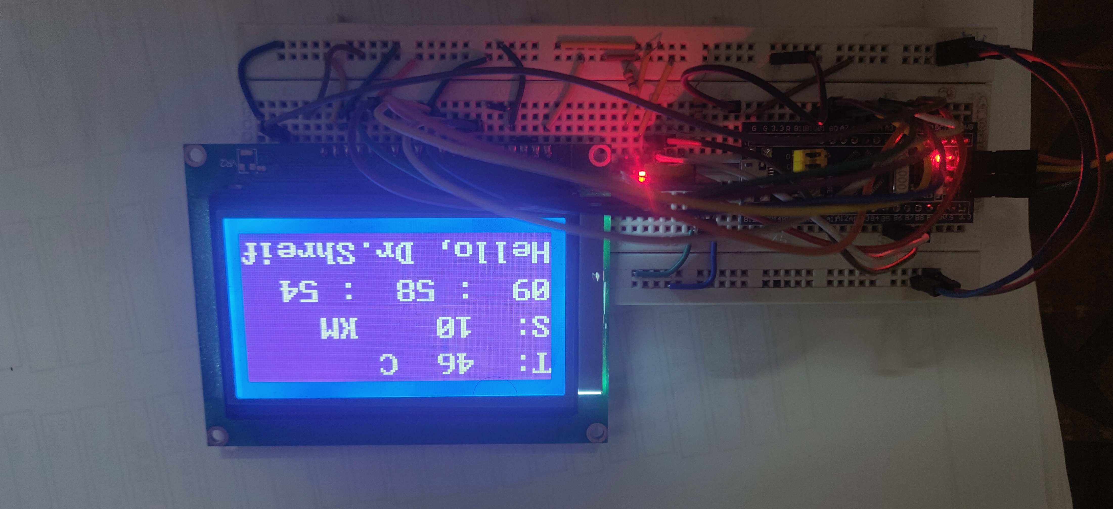

Dashboard system

Slide 63
Dashboard SW ARCHITECURE

Slide 64


Collision system

Slide 65
Tools
Editors and IDEs:
VsCode
Keil IDE To Program Microcontrollers based on arm microprocessor.
ST Link utility for flashing code.
python to create GUI.
draw io to draw diagrams.
Version control and Repository:
git for version control to record changes in files.
GitHub to allow for seamless collaboration without compromising the integrity of the original project.
GitHub repo:
https://github.com/mohamed-hafez-mohamed/Graduation_Project_2021

Slide 66
Thank you

